Slide 1

PRESENTED BY-JAGANNATH MAHANTA
MCA 6TH SEM.
ROLL NUMBER-1905260003
RIMS, ROURKELA

Slide 2
CONTENT:
What is JUnit ?
What is a Unit Test Case ?
Features of JUnit Test Framework
JUnit - Plug with Eclipse
Demo

Slide 3
What is JUnit ?
JUnit is a unit testing framework for Java programming language. It plays a crucial role test-driven development, and is a family of unit testing frameworks collectively known as xUnit.
JUnit promotes the idea of "first testing then coding", which emphasizes on setting up the test data for a piece of code that can be tested first and then implemented. This approach is like "test a little, code a little, test a little, code a little." It increases the productivity of the programmer and the stability of program code, which in turn reduces the stress on the programmer and the time spent on debugging.

Slide 4
What is a Unit Test Case ?
A Unit Test Case is a part of code, which ensures that another part of code (method) works as expected. To achieve the desired results quickly, a test framework is required. JUnit is a perfect unit test framework for Java programming language.

Slide 5
Features of JUnit Test Framework
JUnit test framework provides the following important features −
Fixtures
Test suites
Test runners
JUnit classes

Slide 6
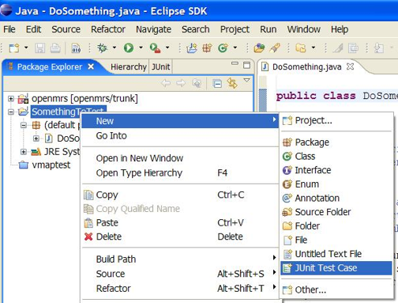
JUnit and Eclipse
To add JUnit to an Eclipse project, click:
Project → Properties → Build Path → Libraries → Add Library... → JUnit → JUnit 5 → Finish
To create a test case:
right-click a file and choose New → Test Case
or click File → New → JUnit Test Case
Eclipse can create stubs of method tests for you.

Slide 7
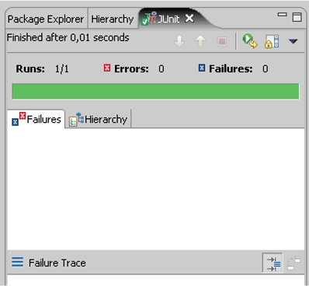
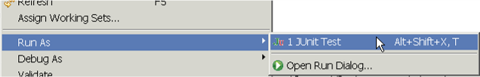
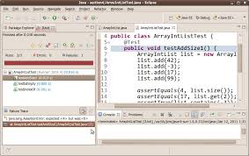
Running a test
Right click it in the Eclipse Package Explorer at left; choose:
Run As → JUnit Test
The JUnit bar will show green if all tests pass, red if any fail.
The Failure Trace shows which tests failed, if any, and why.

